Slide 1

A comparative study of different solar power tracking control techniques.
Problems Encountered
Aims & Objectives
Discussion
Methodology
Outlines
Conclusion
Results
Introduction
Muzzammil Mooraby
&
Dr Sayed Hassen
28th Nov 2018

Slide 2
Solar tracking for optimum power generation using Extremum Seeking control
Introduction
Aims &
Objectives
Methodology
Problems Encountered
Aims & Objectives
Discussion
Methodology
Outlines
Conclusion
Results
Introduction
Discussion
Results
Problems
Encountered
Muzzammil Mooraby
Conclusion
Video demo

Slide 3
Introduction
With the constant depletion of our fossil fuels, engineers are trying to find alternative sources of energy.
Solar energy is the energy which is the most available to us. This energy just needs to be harvested efficiently.
One of the easiest way is by using a solar tracker which can increase energy yield by 20% to 50 %.
.
Solar tracking for optimum power generation using Extremum Seeking control
Problems Encountered
Aims & Objectives
Discussion
Methodology
Outlines
Conclusion
Results
Introduction
Muzzammil Mooraby

Slide 4
Problem definition
Solar tracking for optimum power generation using Extremum Seeking control
Converting irradiation into electricity is the main function of a photovoltaic panel. Then, why not orientate the solar panel towards the maximum power point so that it can yield the most energy?
.
Problems Encountered
Aims & Objectives
Discussion
Methodology
Outlines
Conclusion
Results
Introduction
Muzzammil Mooraby

Slide 5
Aim
The aim is to test the feasibility of a new control algorithm which tracks power output.
.
Solar tracking for optimum power generation using Extremum Seeking control
Objectives
To assess the dependence of photovoltaic systems on solar irradiation.
To determine the types of systems available to track the sun.
To assess the difference between open and closed loop systems.
To design and model an extremum seeking controller(ESC).
To do a comparative study of ESC and other methods available.
.
Problems Encountered
Aims & Objectives
Discussion
Methodology
Outlines
Conclusion
Results
Introduction
Muzzammil Mooraby

Slide 6




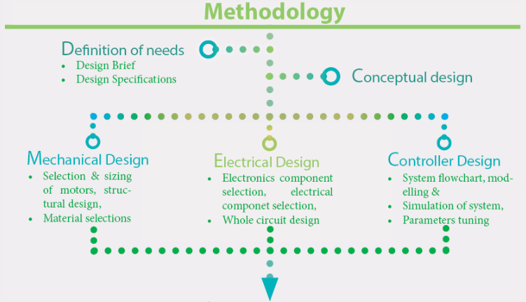
Solar tracking for optimum power generation using Extremum Seeking control
Problems Encountered
Aims & Objectives
Discussion
Outlines
Results
Methodology
Conclusion
Introduction
Muzzammil Mooraby

Slide 7



Solar tracking for optimum power generation using Extremum Seeking control
Problems Encountered
Aims & Objectives
Discussion
Outlines
Results
Methodology
Conclusion
Introduction
Exp 1
Exp 2
Exp 3
Exp 4
Muzzammil Mooraby
ESC
Non-tracking
Calculation
P&O
CLC
OLC
CLC

Slide 8
How experiment was conducted ?
All experiments were performed at the same exact location.
Data were collected on a PC
All data were resampled at a rate of 15 minutes.
The test duration of all experiments were the same.
Solar tracking for optimum power generation using Extremum Seeking control
Problems Encountered
Aims & Objectives
Discussion
Methodology
Outlines
Results
Conclusion
Introduction
Muzzammil Mooraby
Design constraint
All experiments were performed within a week.
The highest light sensor values, were considered

Slide 9

Problem
1
Solar tracking for optimum power generation using Extremum Seeking control
Mechanical Issue : Getting the required range of motion
Problems Encountered
Even though simulations on solidworks have shown otherwise, the prototype did not respond as expected.
Aims & Objectives
Discussion
Methodology
Outlines
Results
Conclusion
Introduction
Muzzammil Mooraby
Solution
The system was redesigned specifically to work during the experiments. By doing so, stability was increased and vibrational stresses were reduced.

Slide 10
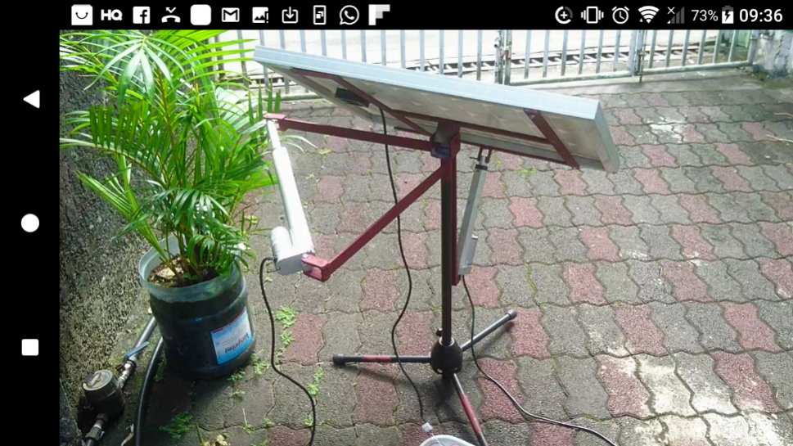
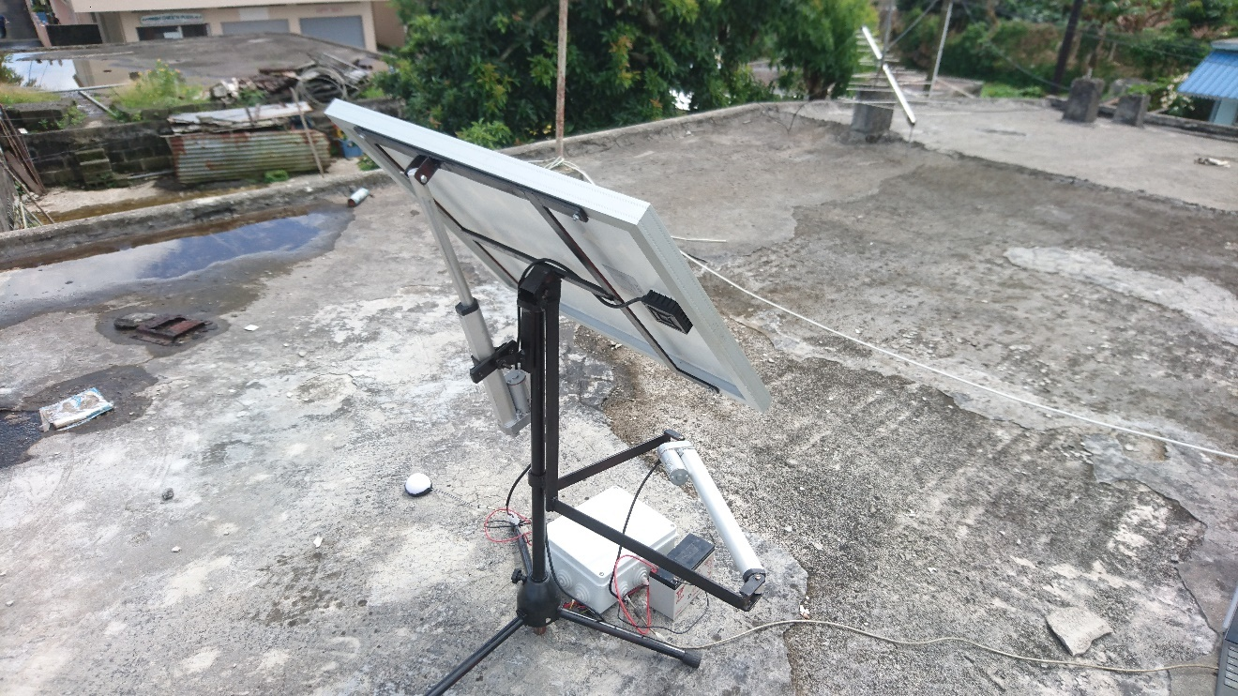
Solar tracking for optimum power generation using Extremum Seeking control
Problems Encountered
Aims & Objectives
Discussion
Methodology
Outlines
Results
Conclusion
Introduction
Muzzammil Mooraby
Before
After

Slide 11
Problem
2
Solar tracking for optimum power generation using Extremum Seeking control
Controller Issue
The precision and accuracy of the controller depend on several factors:
Hardware properties
Weather conditions
Parameters of the algorithm
Problems Encountered
Aims & Objectives
Discussion
Methodology
Outlines
Results
Conclusion
Introduction
Muzzammil Mooraby
Solution
The right tradeoff between accuracy and precision had to be chosen for the parameters, so that the tracker could work in all weather conditions.

Slide 12
Problem
3
Solar tracking for optimum power generation using Extremum Seeking control
Light sensor issue
Could not get access to an appropriate sensor
The LDR operates in a very small range of input.
Problems Encountered
Aims & Objectives
Discussion
Methodology
Outlines
Results
Conclusion
Introduction
Solution
Muzzammil Mooraby
To be able to measure sun light intensity, the light source was to be attenuated.

Slide 13
Result 1
Solar tracking for optimum power generation using Extremum Seeking control
Problems Encountered
Aims & Objectives
Discussion
Outlines
Discussion
References
Methodology
Conclusion
Results
Conclusion
Introduction
Muzzammil Mooraby

Slide 14
Result 2
Solar tracking for optimum power generation using Extremum Seeking control
Problems Encountered
Aims & Objectives
Discussion
Outlines
Discussion
References
Methodology
Conclusion
Results
Conclusion
Introduction
Muzzammil Mooraby

Slide 15
Result 3
Solar tracking for optimum power generation using Extremum Seeking control
Problems Encountered
Aims & Objectives
Discussion
Outlines
Discussion
References
Methodology
Conclusion
Results
Conclusion
Introduction
Muzzammil Mooraby

Slide 16
Energy yield
Solar tracking for optimum power generation using Extremum Seeking control
Problems Encountered
Aims & Objectives
References
Discussion
Methodology
Outlines
Conclusion
Results
Introduction
Conclusion
Muzzammil Mooraby
Overall ESC and P&O collected the most amount of energy.
.

Slide 17
Net Resultant Energy
Solar tracking for optimum power generation using Extremum Seeking control
Problems Encountered
Aims & Objectives
References
Discussion
Outlines
Results
Methodology
Conclusion
Introduction
Muzzammil Mooraby
It can be observed that the Calculation based system has better net energy yield.
.

Slide 18
Conclusion
The power tracker has been successfully realised. It has been achieved with a mixed result. Although it harvests more energy than the compared methods, the net energy received is considerably lower.
For Mauritius, a fuzzy logic algorithm combining ESC and calculation based method should improve accuracy and precision. Hence, yielding more energy than any tested system in this research.
Also, all objectives have been achieved in the research
Solar tracking for optimum power generation using Extremum Seeking control
Problems Encountered
Aims & Objectives
References
Discussion
Methodology
Outlines
Conclusion
Results
Introduction
Muzzammil Mooraby

Slide 19
List of references
“Our Energy Choices: Coal and Other Fossil Fuels | Union of Concerned Scientists,” Union of Concerned Scientists. [Online]. Available: http://www.ucsusa.org/clean-energy/coal-and-other-fossil-fuels#.Wf1v9WhL-Uk. [Accessed: 04-Nov-2017].
Caroline Thompson, “The Effects of the Angle of Sunlight on a Solar Panel | LIVESTRONG.COM,” 2015. [Online]. Available: https://www.livestrong.com/article/197888-the-effects-of-the-angle-of-sunlight-on-a-solar-panel/. [Accessed: 29-Oct-2017].
S. Z. S. Hassen and I. R. Petersen, “Extremum Seeking Control of an Optical Cavity ⋆,” pp. 11787–11792, 2014.
Solar tracking for optimum power generation using Extremum Seeking control
Problems Encountered
Aims & Objectives
References
Discussion
Methodology
Outlines
Conclusion
Results
Introduction
Muzzammil Mooraby
Notes:
Here is my list of references

Slide 20
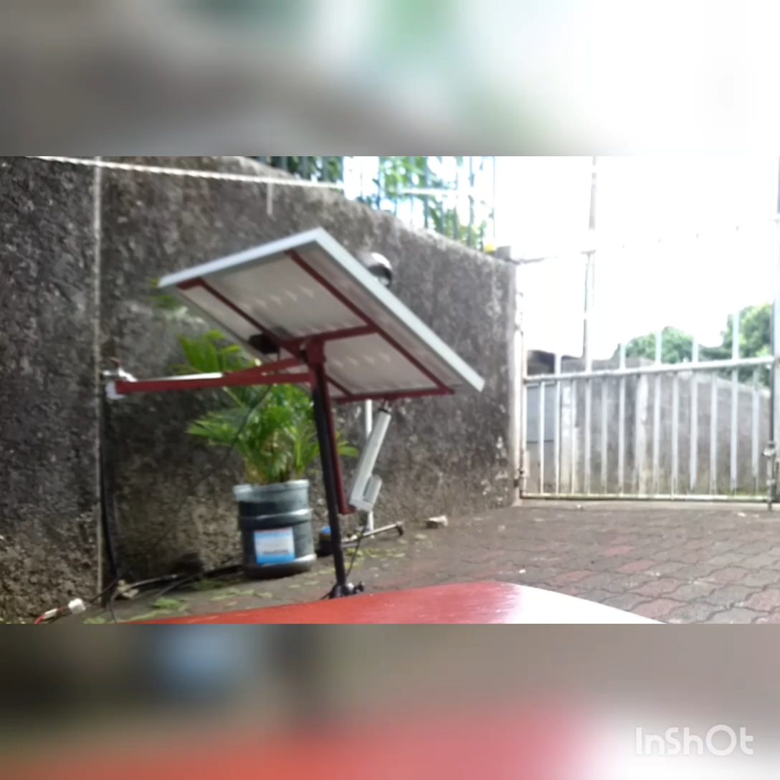

Slide 21
THANK YOU

